Slide 1


Cracking My Wi-Fi Password
John Mercer

Slide 2


Contents
Intro to cracking Wi-Fi passwords
Wireless setup
Virtual Machine setup
Cracking passwords
Future opportunities

Slide 3
Intro to Cracking Wi-Fi Passwords
During Week 9 on day 1, we had an activity to crack a wireless password
We were provided with a capture and used aircrack-ng to determine the key
We then used that key to decode the traffic
I wanted to recreate that exercise using my own equipment and network

Slide 4
Equipment for the test
Network and capture
TP-link TL-WR940N Wireless Router
TP-link Archer T9UH wireless adapter
Acrylic Wifi Sniffer software (ver 1.36)
Wireshark software (ver 3.6.7)
VM and Cracking
VirtualBox software (ver 6.1.36)
Ubuntu OS (ver 22.04.1)
aircrack-ng software

Slide 5
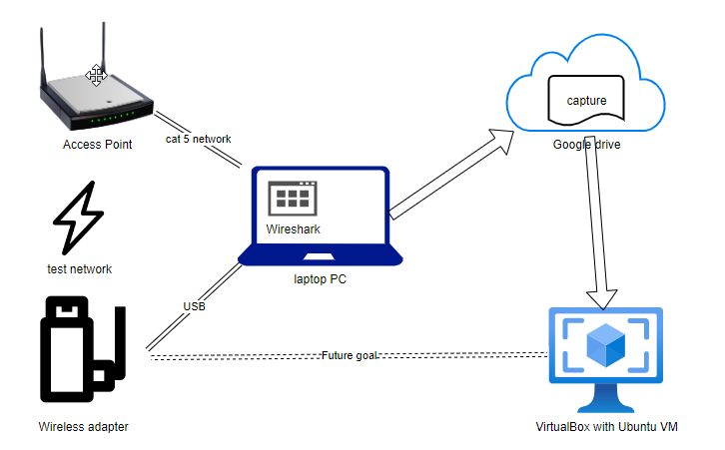
Network Diagram

Slide 6
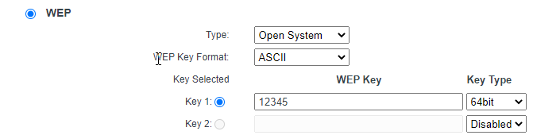
Setting up Wi-Fi Network
Access point is configured via web page on PC connected to wired port on the router
Router offers security using none, WEP, or WPA/WPA2
Configure for WEP with 64-bit key and ASCII format

Slide 7
Setting up Wireless Adapter
To capture wireless traffic, the adapter needs to be in monitor mode
The built-in wireless adapters in most laptops do not support this mode
I needed an external, USB-connected adapter
Even then Wireshark may not be able to monitor
I used Acrylic WiFi Sniffer software to allow monitor mode

Slide 8
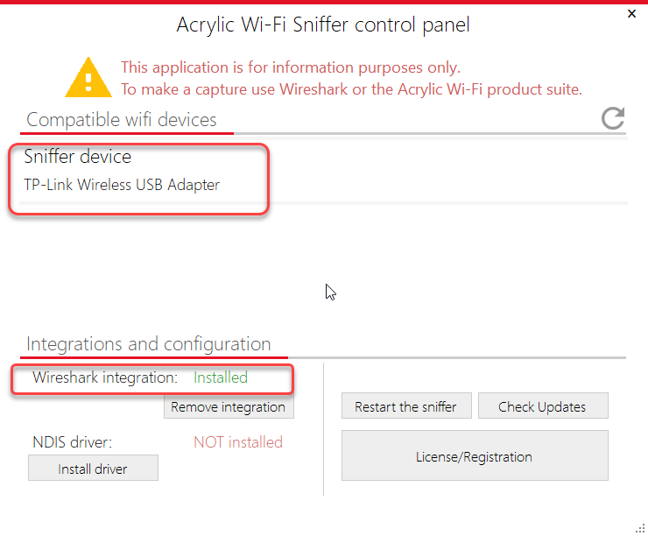
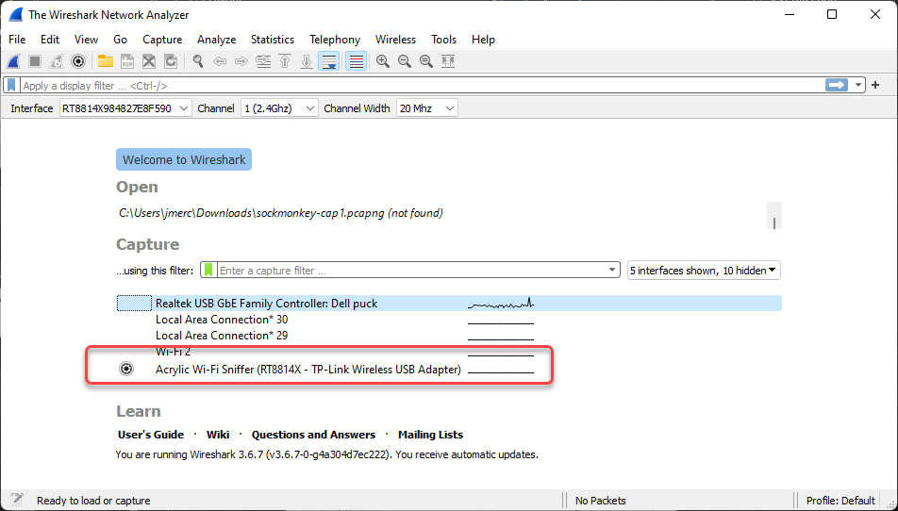
Software Screenshots
Acrylic control panel
Wireshark

Slide 9
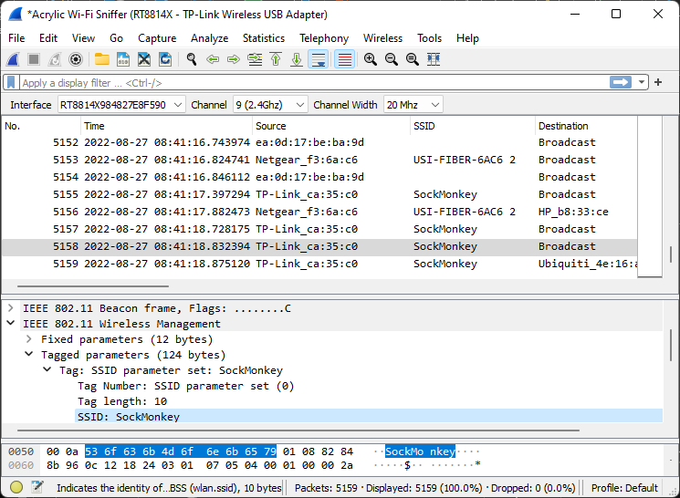
Wireshark capture

Slide 10
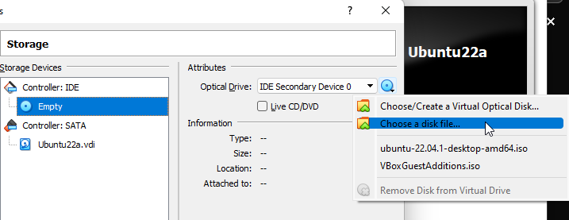
Setting up a new virtual machine
For future compatibility, I upgraded VirtualBox
Installed VirtualBox Extension Pack for USB pass-thru
Created a new Virtual machine
Make sure to give it enough disk space & RAM
I downloaded the ISO file for Ubuntu Desktop
Under new machine | Settings | Storage | IDE | Empty disk | <disk dropdown> | Choose a disk file | select the ISO file

Slide 11
Install the Operating System
The virtual machine will boot to the setup program
Answer questions about updating, disk layout, time zone, account, and password.
Installation will run and prompt for reboot at end
Reboot and you can log into the new OS
It will prompt for an update to the OS

Slide 12
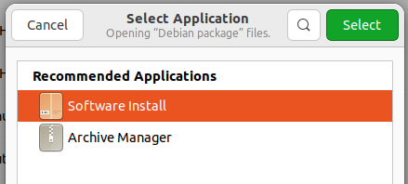
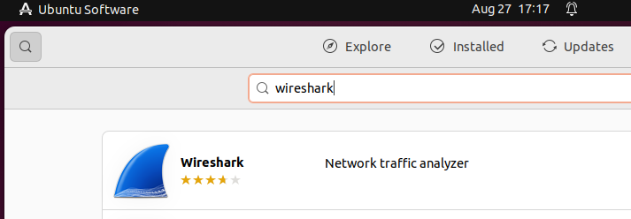
Install Software
Install VirtualBox Guest Additions
Device menu | Insert Guest Additions CD image…
sudo apt-get install aircrack-ng
Install Chrome browser from web
Download .deb file
Right-Click| Open with Software Install
Install Wireshark from Ubuntu Software GUI

Slide 13
Complete the capture
Stop the Wireshark capture
Save image as .pcap file (second file type on list)
Upload file to Google Drive
Or use VirtualBox Drag and Drop

Slide 14
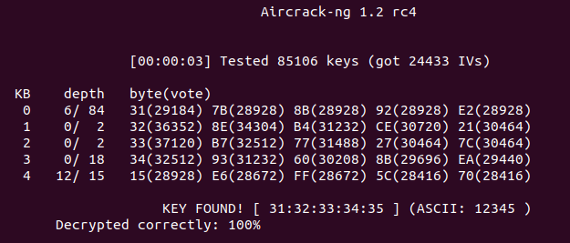
Crack the Wi-Fi key
Download the new file from Google Drive
In terminal: sudo aircrack-ng <newfile.pcap>
Select the desired SSID

Slide 15
Test Results
Test No. | Duration (min) | No. of packets | Aircrack-ng IVs (SockMonkey) | Results
1 | 10 min | 78,882 | 62,226 | Success
2 | 5 min | 32,171 | 24,433 | Success
3 | 3 min | 7032 | 3559 | Failed
4 | 4 min | 5159 | 0 | Failed
5 | 8 min | 10,036 | 841 | Failed
6 | 10 min | 12,068 | 1101 | Failed
7 | 15 min | 15,313 | 742 | Failed
8 | 15 min | 15,024 | 225 | Failed
9 | 60 min | 8933 | 4 | Failed

Slide 16
Future Opportunities
Using VirtualBox Extension Pack, connect USB adapter to Ubuntu VM
Need to install drivers for adapter
Some depend on files no longer part of OS
Might need to try older versions of OS
Would allow for direct use of Wireshark and aircrack-ng utilities for cracking WPA/WPA2
Testing 128bit and 152bit WEP keys

